Slide 1
Lead Scoring Assignment

Slide 2
Index:
Introduction
Problem Statement
Data Cleaning
Outliers
Conclusion
Recommendations

Slide 3
Introduction:
Understand how assigning values to leads guides strategic sales and marketing focus.
Explore challenges faced by X Education in lead management and conversion.
Learn about X Education's solution—implementing a lead scoring system for targeted efforts.
See how X Education used lead scores to prioritize high-potential leads and boost efficiency.
showcasing the success and improvements brought by lead scoring at X Education.

Slide 4
Problem Statement:
X Education wants me to create a lead scoring model to pinpoint the most promising leads-those with higher scores will likely convert into paying customers.
By analyzing key factors, I'll design a system where lead scores directly correlate with conversion chances, offering a strategic tool for lead prioritization and increased conversion rates.

Slide 5
Steps Taken:
Import the Data For Analysis
Data Understanding and inspection
Data Cleaning
Data Analysis (EDA)
Data Preparation
Feature Scaling
Model Building
Model Evaluation
Making Predictions on test set

Slide 6
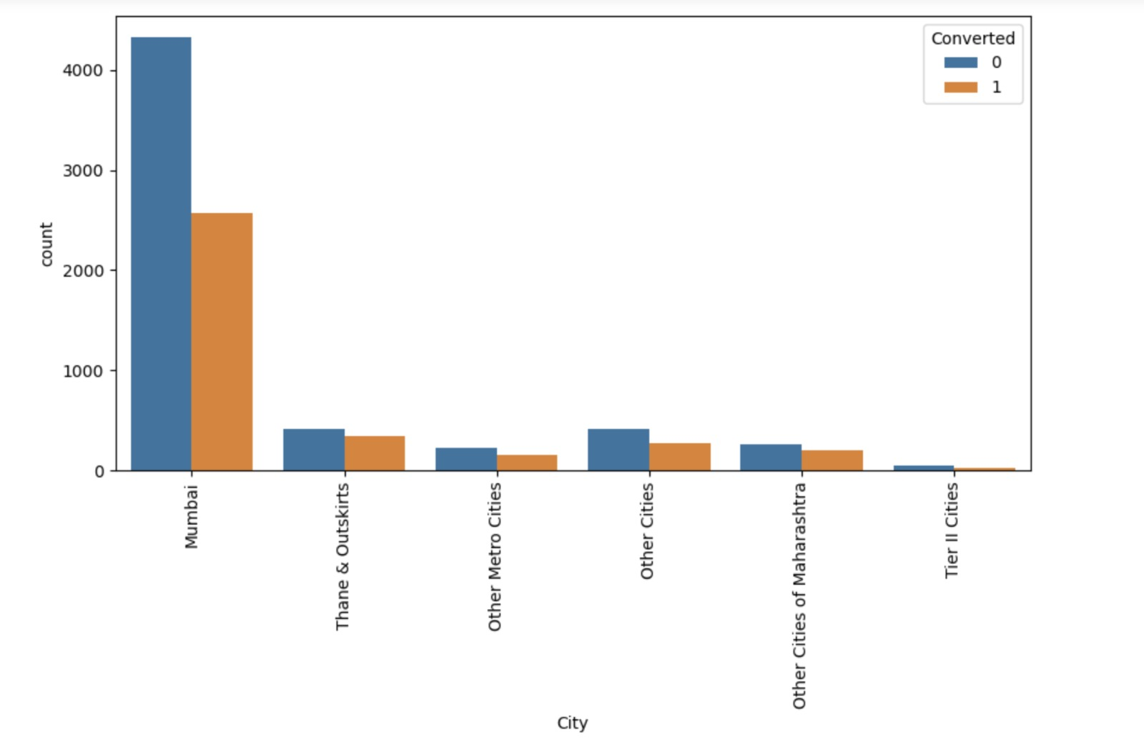
Visuals after replacing null values

Slide 7
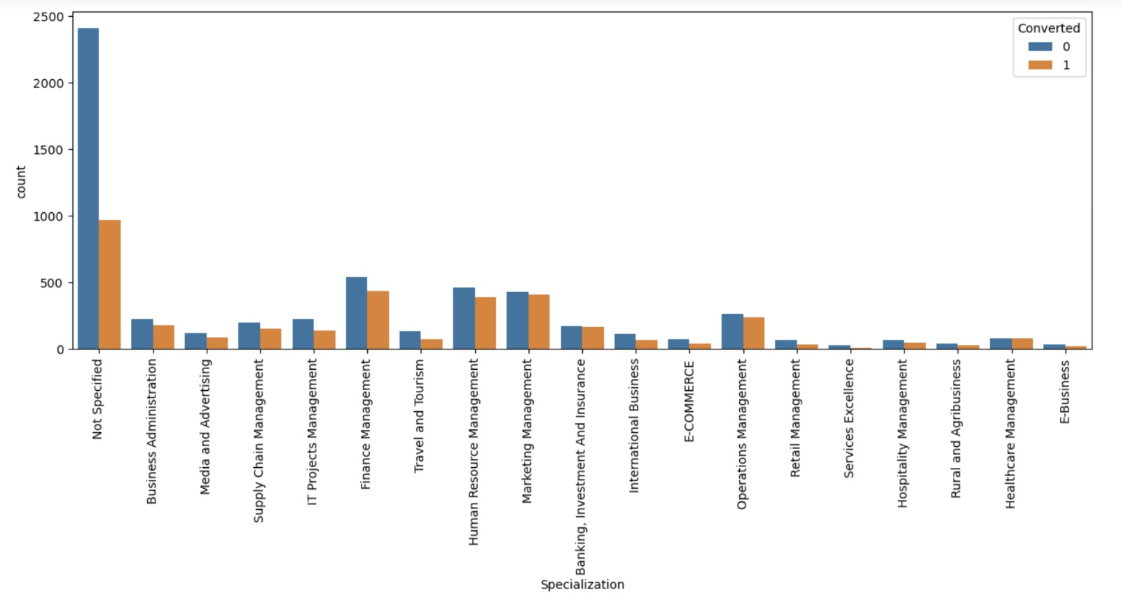
Plotting Spread of Specialization:

Slide 8
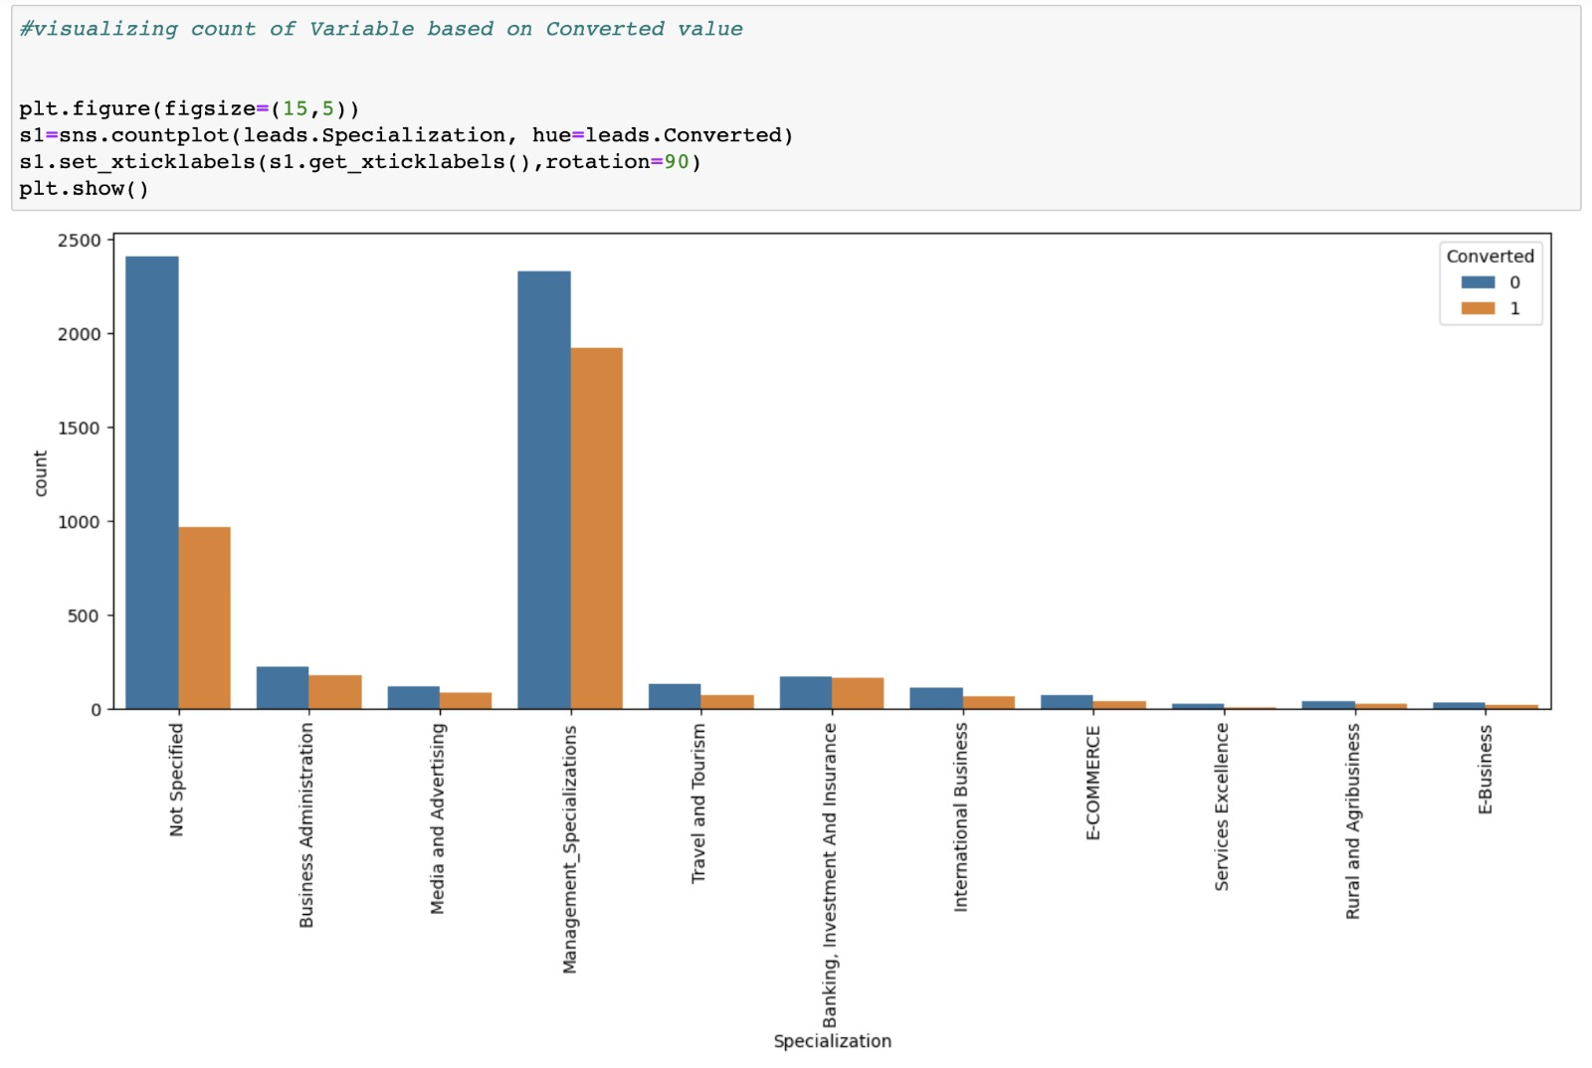

Slide 9
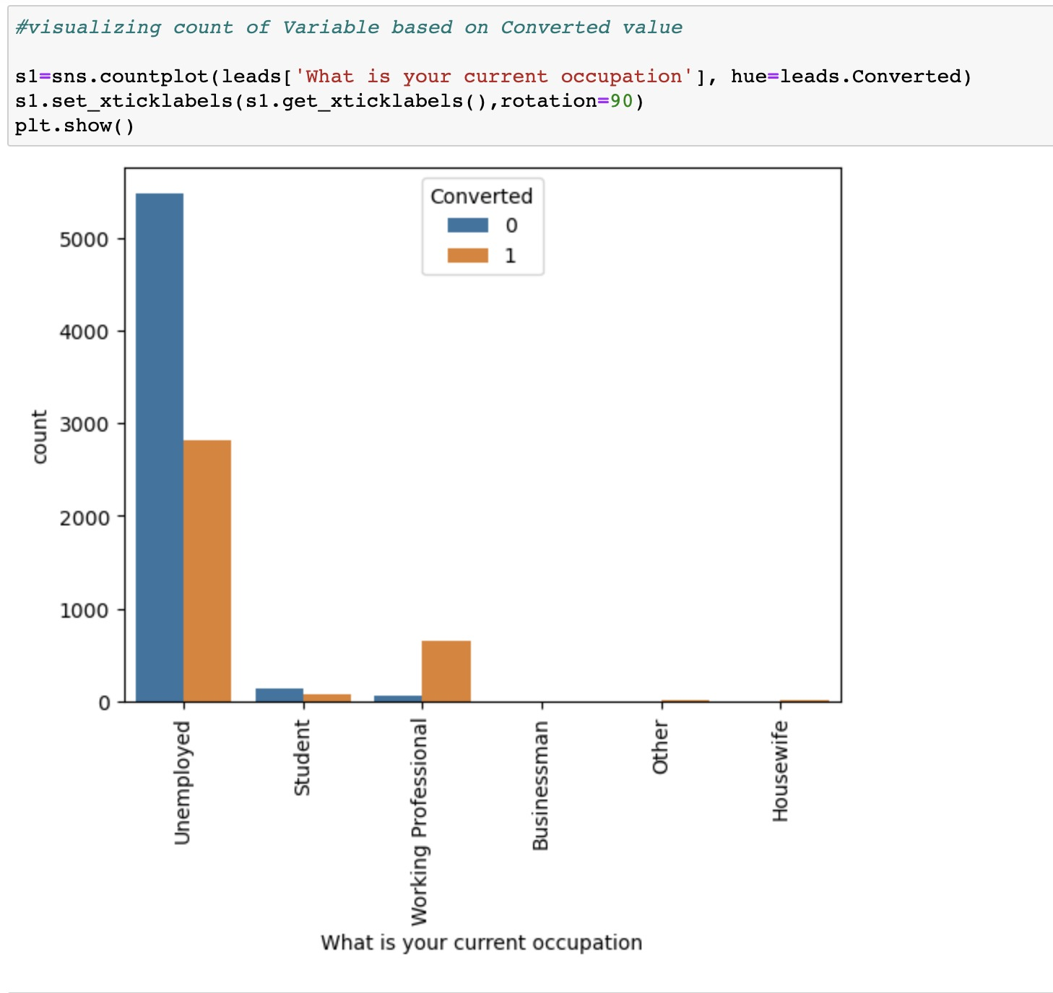

Slide 10
Conclusion:
Analyzing lead data reveals that 52% of leads come from "Landing Page Submission" with a 36% lead conversion rate (LCR), while "API" identifies 39% with a 31% LCR.
In terms of current occupation, 90% are unemployed, boasting a 34% LCR, whereas working professionals, forming 7.6% of customers, have an impressive 92% LCR.
A noteworthy 92% of individuals prefer not to receive emails about the course. Regarding lead sources, Google leads with a 40% LCR, surpassing Direct Traffic (32% LCR), Organic Search (37.8% LCR), and Reference (91% LCR, but only 6% of customers).

Slide 11
Recommendations:
Target Positive Coefficients :Focus marketing on features with positive coefficients for improved lead conversion.
Optimize Top Lead Sources: Develop strategies to attract high-quality leads from top-performing sources.
Engage Working Professionals: Tailor messaging to engage working professionals, leveraging their high conversion rates.
Boost Website Advertising: Increase budget for Selinga website advertising to enhance visibility.
Incentivize Referrals, Analyse Weaknesses: Encourage referrals with incentives, analyse negative coefficients for improvement, and review landing page submission processes.

Slide 12
Thank you

